Slide 1
Parameter Ranking Definitions – Business and Technical
Business Parameters | Ranking Definition
Compliance (Coverage of Compliance requirements) | Number of compliance requirements and clearances met by the provider
Cloud Hosting Locations (Geographic Footprint) | Presence of hosting locations across various regions/countries globally
Cloud Service Model (Breadth of Service Offerings) | IaaS, PaaS, SaaS offerings across vendors
Enterprise Support (Support provided by Vendor) | Type of support provided along with response time
Service SLA (Availability of Cloud) | Uptime achieved by the respective vendors
Technical Parameters | Ranking Definition
Network Capability (Network Related Components) | Network related Protocols supported
Support for Technology (HW/SW Compatibility) | Software and Hardware Compatibility offered by cloud vendors
Capacity & Configuration Limits (Min and Max limits offered) | limitations in the capacity offered. Higher capability gets a better score
Data encryption & Security (Data Protection) | Encryption levels and data security provided by the vendor

Slide 2
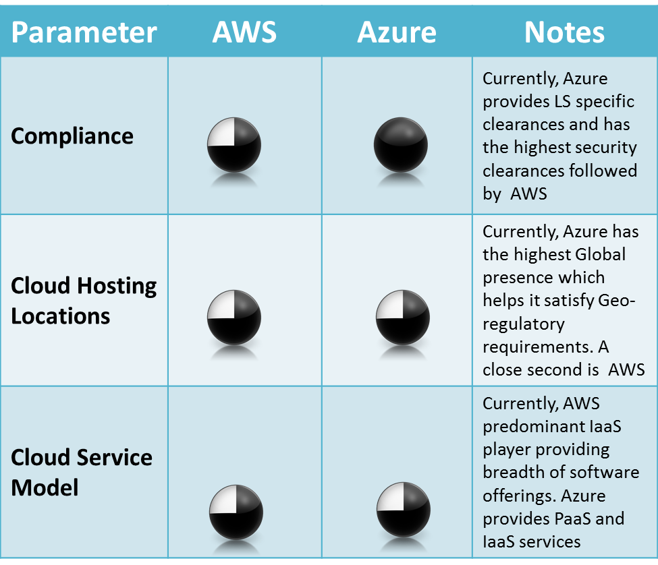
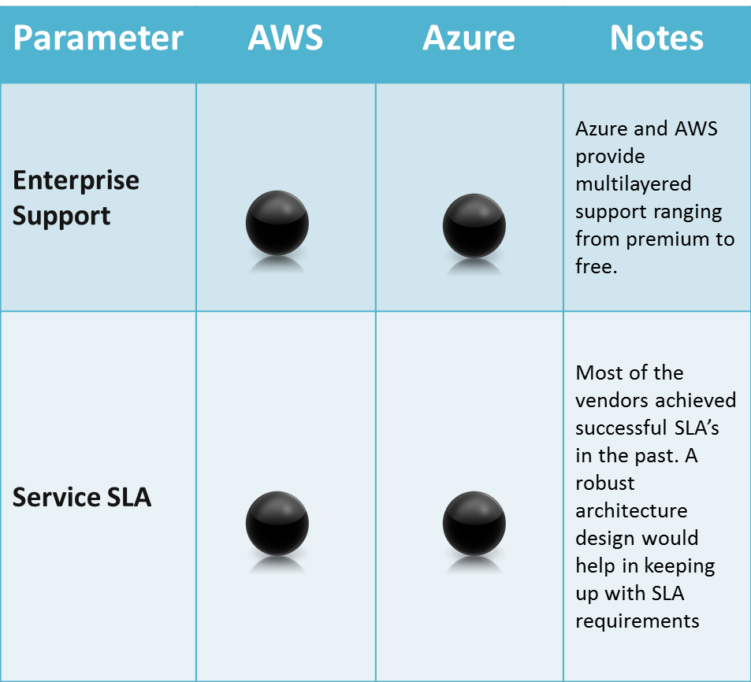
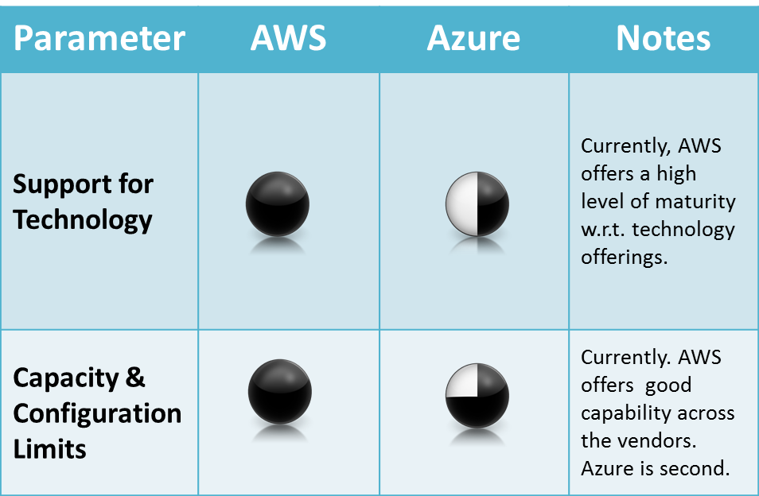
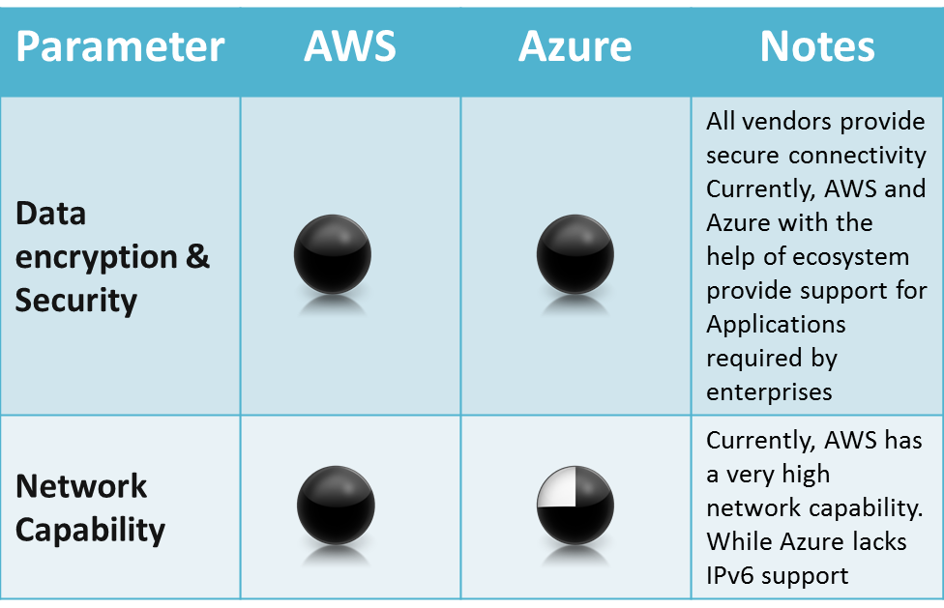
AWS: Azure- High Level comparison
Business Parameters
Technical Parameters

Slide 3
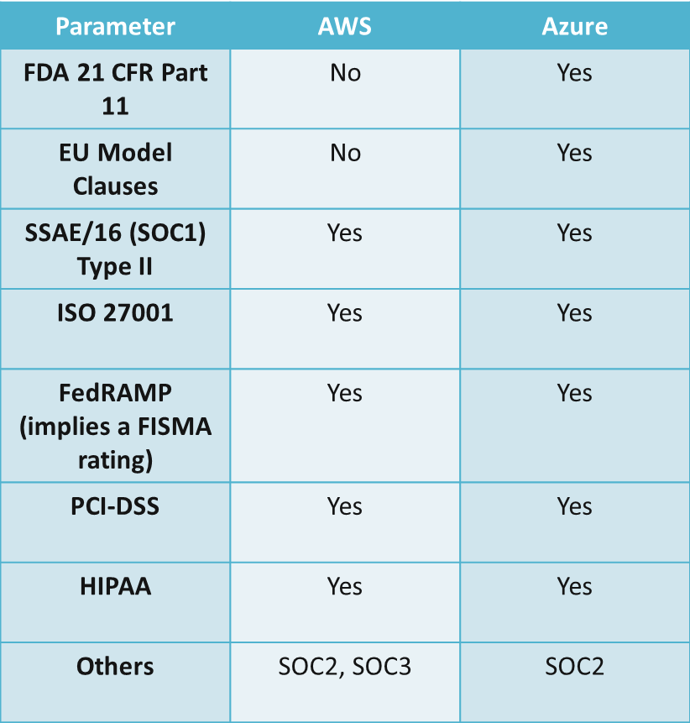
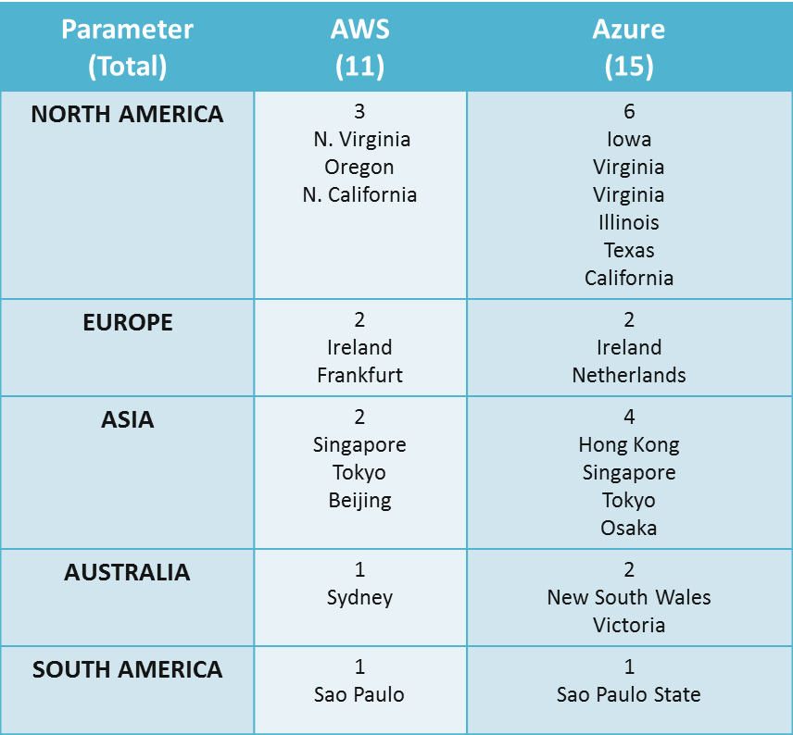
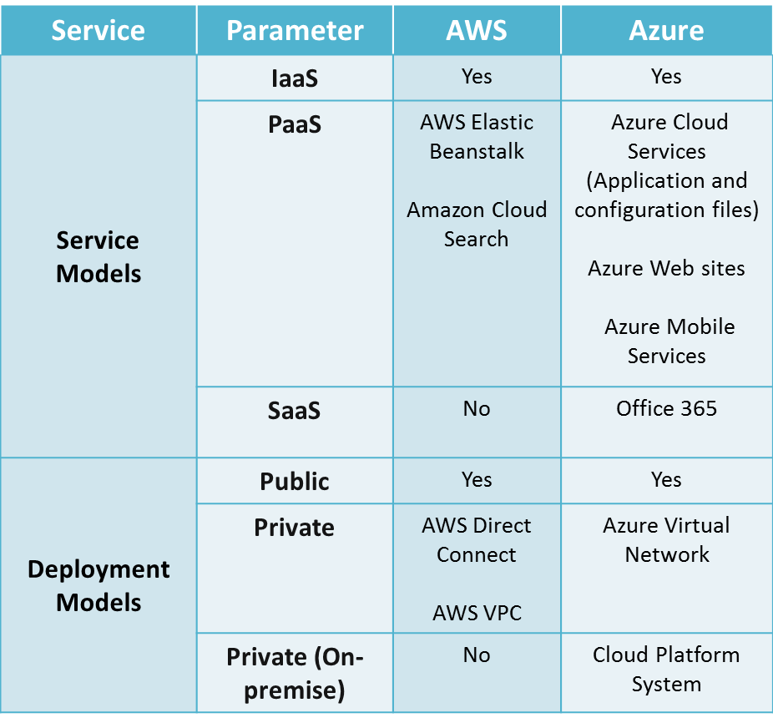
AWS: Azure- High Level comparison

Slide 4
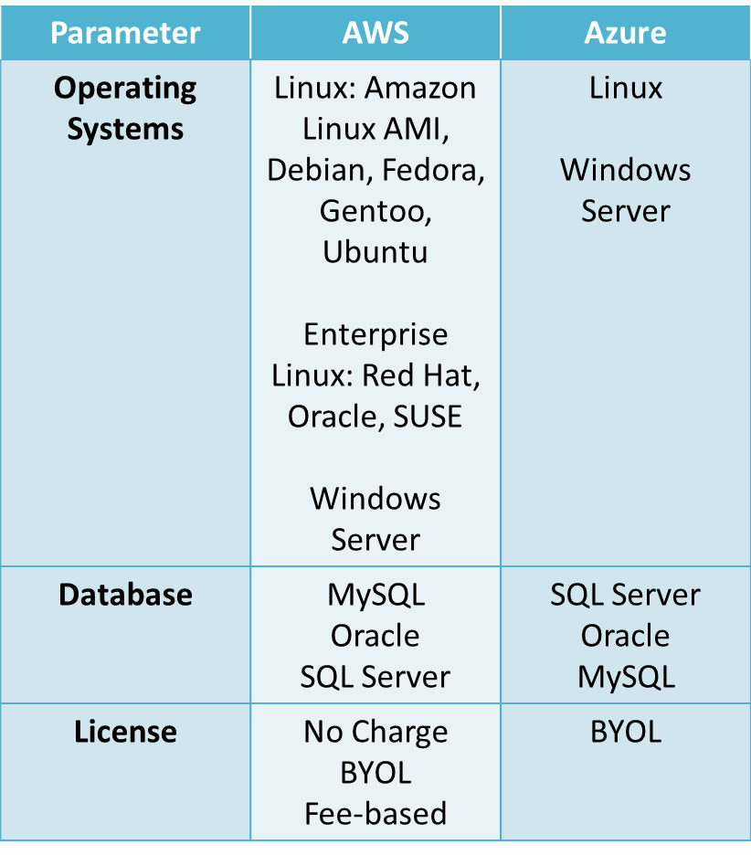
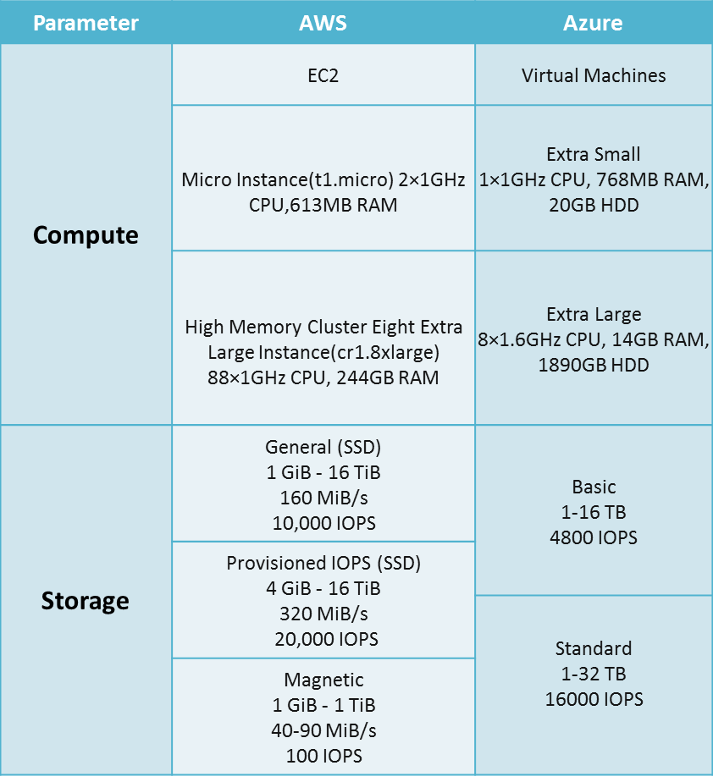
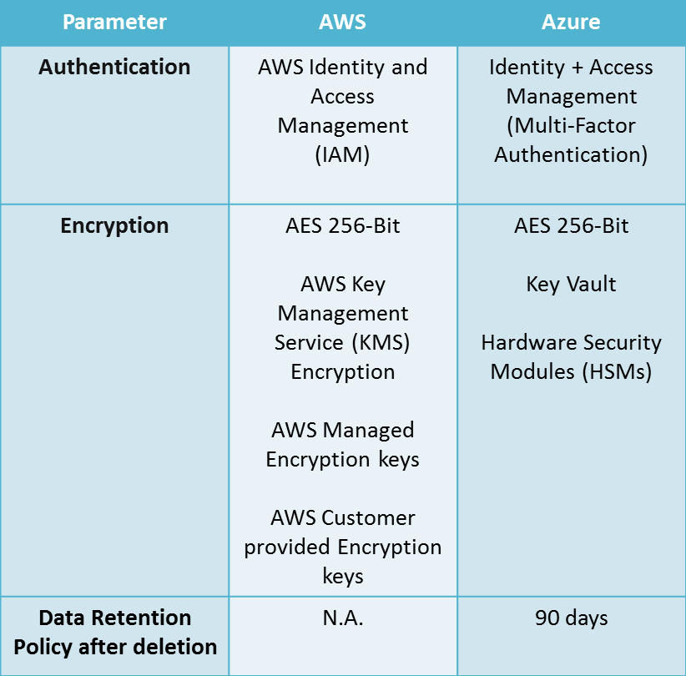
AWS: Azure- High Level comparison

